Slide 1
Naloxone Community Training Keep the Circle Strong: Combating the Opioid Epidemic within our Communities
Insert Presenter’s Name Here
Presentation developed by the IHS National Committee on Heroin Opioids and Pain Efforts (HOPE Committee)
Notes:
Community Naloxone training
Our role in Combating Opioid Epidemic in our Community
Save a life.

Slide 2
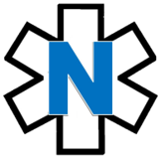
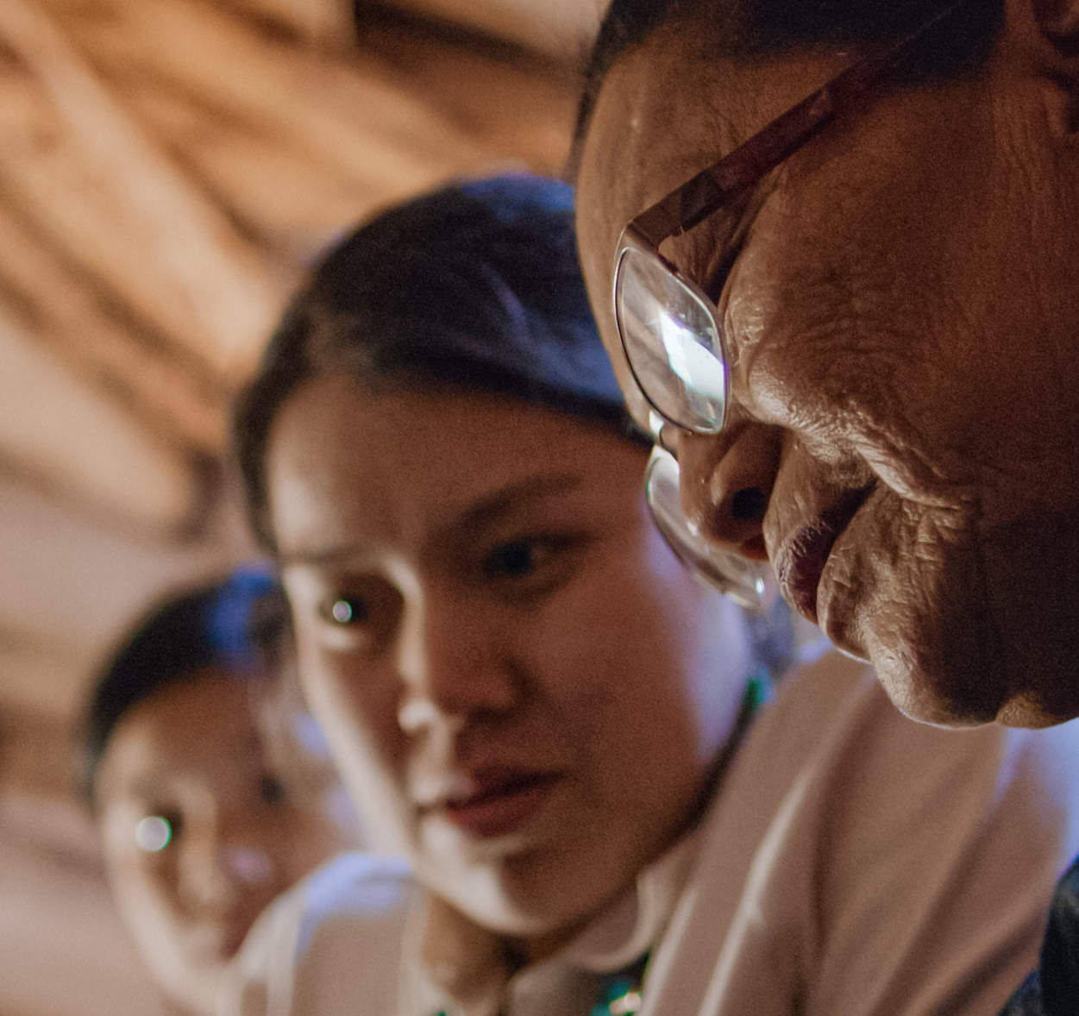
Community Naloxone Training Topics
Community Naloxone
Training Topics
Why should I learn about naloxone?
What is an opioid overdose?
Who is at risk?
How do we know an overdose is occurring?
What our words mean: Key Definitions
What is naloxone and how can is stop an overdose?
Naloxone in action
Putting it all together
Getting naloxone
Notes:
Agenda.

Slide 3
What our words mean Key definitions
Topic 1

Slide 4
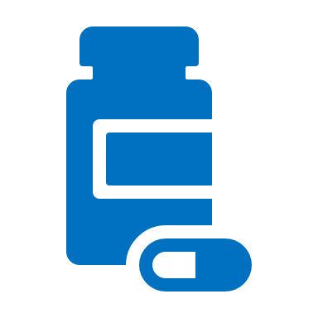
What our words mean Key definitions
Opioids
Opioids are substances that may include:
Prescription medications used to treat pain (hydrocodone, hydromorphone, morphine, codeine, oxycodone, fentanyl)
Medications to assist substance use disorder treatments (buprenorphine, methadone)
Illicit drugs (heroin, illegally-created fentanyl)
Overdose
An overdose is a severe and sudden condition resulting from an excessive amount of opioid being swallowed, inhaled, injected or absorbed through the skin, intentionally or unintentionally, leading to possible death.
Naloxone
Naloxone is a safe and life-saving medication that can reverse an overdose from all types of opioids - including heroin, fentanyl, and prescription medications - when given in time.
Notes:
First things first – let’s gather a common understanding of the words we will be use today....
Opioids:
Slang terms include: OCs, Oxy, perks, vics, smack, junk, black tar, ills, skittles, blues, rails, feddy. (NOTE: there may be others that are more locatlized, cons adding.)
https://store.samhsa.gov/sites/default/files/d7/priv/sma18-4742.pdf
Overdose
Severe and sudden, may also hear the term “acute”
Naloxone
May hear the common prescription of “Narcan”

Slide 5
Why should I learn about naloxone?
Topic 2

Slide 6
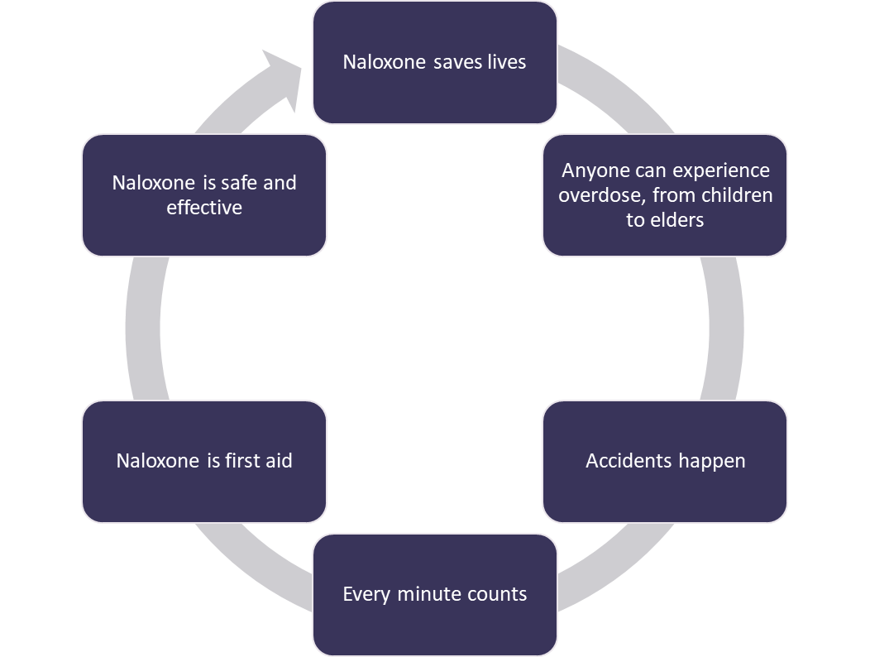
I carry naloxone because…
Naloxone keeps the circle strong
Notes:
We are learning about Naloxone because it is an essential tool to save a life.
Unfortunately, anyone can experience an overdose. We all make mistakes, and sometimes we grab the wrong medication or misread instructions.
Sometimes family members may not know they are at a higher risk of an overdose, like if they have chronic health problems like COPD.
There is a great deal of stigma around persons with Substance Use Disorder, or SUD. This may stem from a belief that SUD is a personal choice or a moral failing rather than a chronic, treatable disease from which patients can recover and continue to lead healthy lives. This stigma also contributes to negative attitudes toward Naloxone and the false belief that naloxone is only needed for persons with OUD. This continues to be a major barrier to naloxone distribution and harm reduction efforts to prevent opioid overdose.
Did you know :
American Indian/ Alaska Native overdose rates increased by 39% between 2019-2020.
Some conditions in the places where people live, work, and play can widen these disparities. For instance, rural areas and low income areas have higher rates of overdose deaths.
Comprehensive, community-based prevention and response efforts should incorporate proven, culturally responsive actions that address disparities in drug overdose deaths and the inequities that contribute to them.
https://www.cdc.gov/vitalsigns/overdose-death-disparities/index.html

Slide 7
What is an opioid overdose?
Topic 3

Slide 8
What is an opioid overdose?
1. A person takes more opioids than their body can handle
2. Breathing slows as the opioid suppresses the urge to breath
3. Breathing stops and carbon dioxide builds up in their body
4. Oxygen levels decrease, which leads to brain damage
5. Their heart stops
Notes:
As we talked about in the last slide, overdoses can unfortunately occur in anyone. They are accidents. We should learn what happens during an overdose.
Opioids suppress the urge to breath
Carbon dioxide levels increase
Oxygen levels decrease
Process takes time
There is time to respond, but no time to waste

Slide 9
Who is at risk?
Topic 4

Slide 10
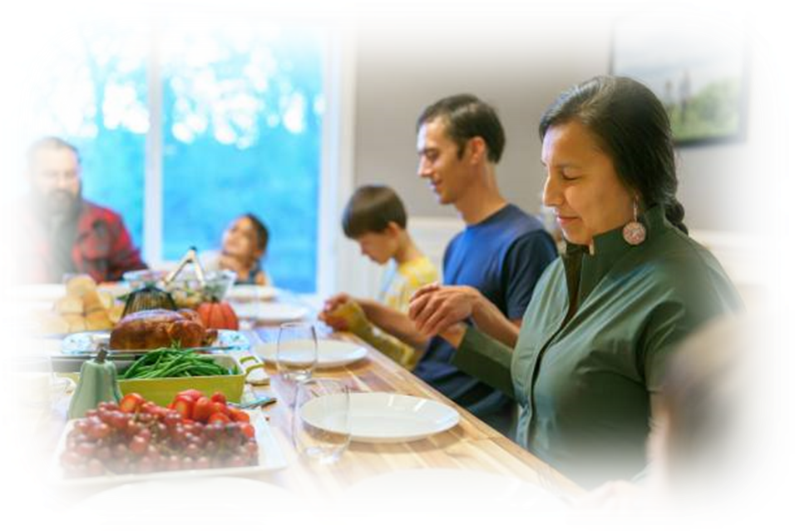
Keep your circle strong: Know who is at risk
An opioid overdose can happen to anyone in your home
Chronic health issues: COPD, asthma, sleep apnea, dementia
Someone prescribed high opioid medicine dosages
Elders
Intellectual or physical impairments
Curious young child
Someone recently in a drug treatment program or in jail
An IV drug user
Uses multiple sedating medications
History of substance use
In nearly 40% of overdose deaths, someone else was present
Notes:
Note for recently in jail/drug treatment:
Tolerance develops when someone uses an opioid drug regularly so that their body becomes accustomed to the drug and needs a larger or more frequent dose to continue to experience the same effect.
Loss of tolerance occurs when someone stops taking an opioid after long term use. When someone loses tolerance and then takes the opioid drug again, he or she can experience serious adverse effects, including overdose, even if the amount taken had not caused problems in the past. This can happen when someone was recently in jail or other program. They may not be aware of how much their tolerance has decreased
In nearly 40% of overdose deaths, someone else was present
- Source: https://www.cdc.gov/mmwr/volumes/69/wr/mm6935a1.htm?s_cid=mm6935a1_w

Slide 11
How do we know an overdose is occurring?
Signs of an overdose
Topic 5

Slide 12
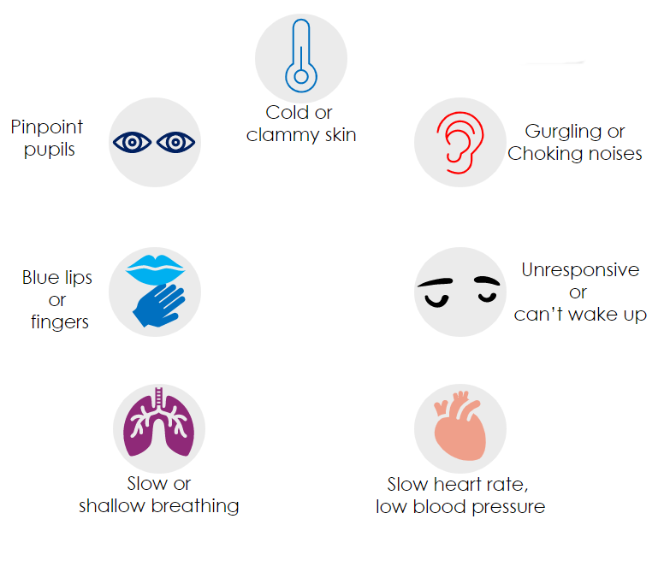
What are the signs of an overdose?
Notes:
List from SAMHSA:
The face is extremely pale and/or clammy to the touch.
The body is limp.
Fingernails or lips have a blue or purple cast.
The person is vomiting or making gurgling noises.
The person cannot be awakened from sleep or cannot speak.
Breathing is very slow or stopped.
The heartbeat is very slow or stopped.

Slide 13
What is naloxone?
Topic 6

Slide 14
What is naloxone?
Naloxone….
Is a life-saving medication
Can be given as a nasal spray
Reverses overdoses from all types of opioids (heroin, fentanyl, and prescription medications)
Can be given even if unsure if an overdose is occurring
Lasts 30-90 minutes, giving you time to call for help
1
Opioids sit on receptors in your brain
Overdose occurring
2
Naloxone enters your body and knocks the opioids away
3
Naloxone sits on the receptors, allowing your body to breathe again
Overdose stopped

Slide 15
Naloxone Myths Debunked
There is no risk if there is no opioid in the blood stream
Bystanders can act to prevent overdose deaths
Most states have laws to protect person overdosing and bystanders
Naloxone is non-addictive and does not lead to more or riskier drug use
Only first responders can save a life of a person experiencing overdose
Naloxone will cause harm
Naloxone is safe to use and can be given to elders, pregnant women and children
Naloxone can be given even if you are unsure if an overdose is occurring
Naloxone encourages drug use, increases addiction, can be misused
Myth
Facts

Slide 16
What does naloxone reverse?
Does reverse
Does not reverse
Morphine
Opioids
Codeine
Oxycodone
Hydrocodone
Fentanyl
Hydromorphone
Oxymorphone
Heroin
Cocaine
Methamphetamines
Diazepam
Alprazolam
Alcohol
Notes:
Slang terms include: OCs, Oxy, perks, vics, smack, junk, black tar, ills, skittles, blues, rails, feddy.
(NOTE: there may be others that are more localized, consider adding for your area.)
https://store.samhsa. gov/sites/default/files/d7/priv/sma18-4742.pdf
Yes:
Oxycodone (ex) - Oxycontin®
Hydrocodone (ex) - Vicodin®, Norco®
Hydromorphone (ex) - Dilaudid®
Oxymorphone (ex) - Opana®
No:
Diazepam (ex) - Valium®
Alprazolam (ex) - Xanax®

Slide 17
Naloxone in action
Topic 7

Slide 18
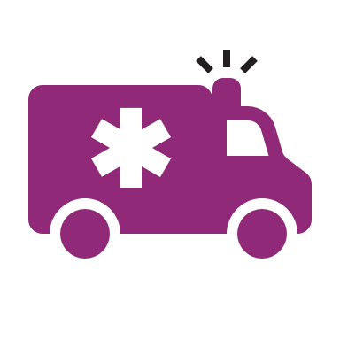
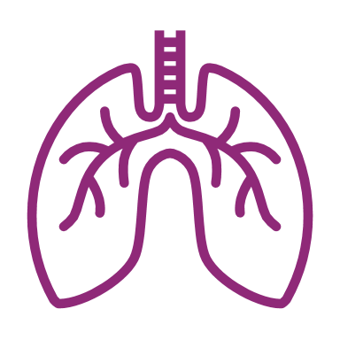
Instructions: Someone is unresponsive and overdose is suspected
Activate 911
Report someone is unresponsive or not breathing.
Be safe! Check your surroundings.
Be careful of things like needles or anything that can be harmful.
Check for signs
Know the signs of an Opioid Overdose
Are there witnesses that can tell you what happened?
Support breathing
Open airways
If certified – begin CPR
Listen to the recommendations of the 911 dispatcher

Slide 19
Prepare to give Naloxone nasal spray
1. Prepare the naloxone spray
Remove naloxone from the box
Peel back the tab with the circle at the top right corner to open
2. Position the person
Tilt the person’s head back and use your hand to support their neck
Hold the naloxone with your first and middle fingers on either side of the nozzle and your thumb on the plunger
Gently insert the tip of the nozzle into one nostril, until your fingers on either side of the nozzle are against the bottom of the person’s nose
Notes:
Spray is FDA-approved – it is a pre-filled, needle-free device that requires no assembly and is sprayed into one nostril while the person lays on their back

Slide 20
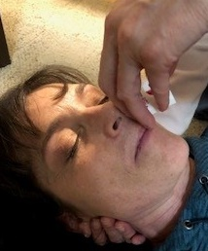
Administer: Naloxone nasal spray
3. Press
4. Observe and repeat
Repeat dose in other nostril within 2-3 minutes until independent breathing begins
5. Recovery
The effect of Naloxone lasts 30-90 minutes
Press the plunger firmly to spray the dose of naloxone into the person’s nostril
Look for independent breathing
If overdose signs set in again, repeat dose to maintain overdose reversal
Roll person onto their side once independent breathing has begun

Slide 21
What to expect when reversing an overdose
Agitation
Nausea and vomiting
Excessive sweating
Runny or bloody nose
Fast heartbeat
High blood pressure

Slide 22
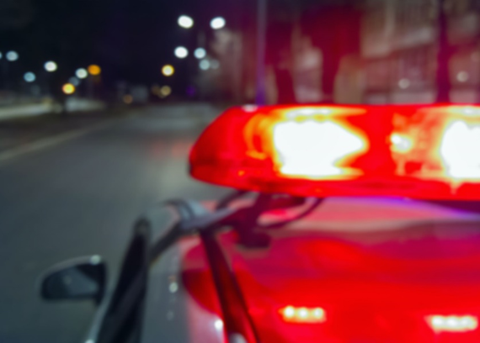
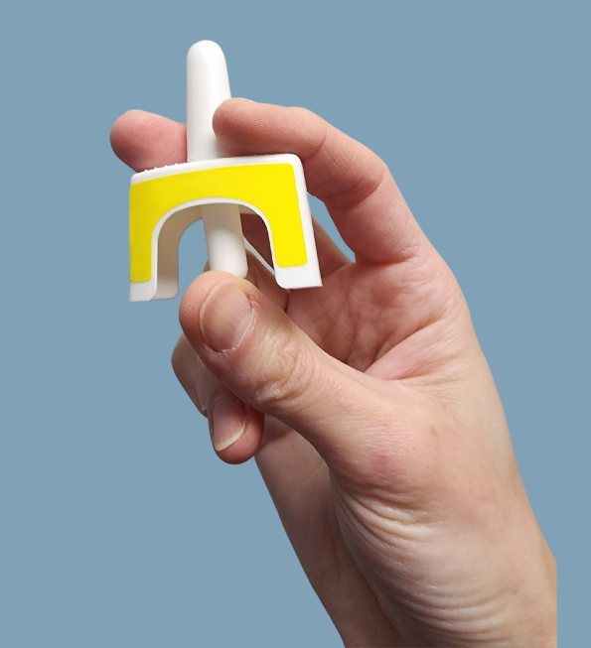
Recap: How you can save a life
Recognize a potential
overdose
Call Emergency
Services
Give naloxone

Slide 23
Key actions to remember
Do lay the person on their side
Do stay with the person and keep them awake
Do monitor the person's response to naloxone
Do call for help
Do let others know you have naloxone (you cannot use on yourself)
Don’t slap or forcefully try to wake the person
Don’t put the person in a cold bath or shower
Don’t inject the person with any substance (saltwater, milk, “speed”, heroin, etc.)
Don’t try to make the person vomit

Slide 24
Accessing and Storing naloxone
Topic 8

Slide 25
Getting access to naloxone
Getting naloxone
Naloxone nasal spray can be obtained at Indian Health Service (IHS) pharmacies.
The pharmacist will go over any questions, training, and will dispense per local policy and procedure.
Replacing naloxone
Be sure to check the expiration date and replace naloxone if expired, damaged or used.

Slide 26
Putting it all together
Topic 9

Slide 27
Putting it all together
This medicine is not harmful if no opioids in bloodstream
Will give time
Is life- saving
Can only help
Can be given at any point during an overdose
Naloxone has become standard in many communities throughout the country
Any delay in administering naloxone can lead to death and injury
It cannot be used to get high or set someone back in their recovery
It is effective usually within 1 to 3 minutes.
The effects last between 30 to 90 minutes – giving you time to get more help!
No negative health outcomes have been reported after over 40 years of utilization
In nearly 40% of overdose deaths, someone else was present
The life-saving benefits of naloxone in reversing opioid overdose is clear

Slide 28
Want to expand your impact?
Want to expand your impact?
Consider teaching others about naloxone.
Watch IHS’ Naloxone Train-the-Trainer video

Slide 29
Thank You!
Thank you for attending this naloxone training.
Remember:
Naloxone distribution is an effective strategy to prevent opioid overdose and death.
Your participation may lead to giving someone a second chance at life.
Naloxone keeps the circle strong

Slide 30
Questions?
Comments?
Thoughts?

